Slide 1


PHYSICAL EDUCATION
TOPIC 1:
RELIGIOUS AND SECULAR FESTIVALS

Slide 2
PHYSICAL EDUCATION
TOPIC 1
RELIGIOUS AND SECULAR FESTIVALS

Slide 3
PHYSICAL EDUCATION
TOPIC 1: RELIGIOUS AND SECULAR FESTIVALS
TEH ANO ABI ANG MGA FESTIVALS?

Slide 4
PHYSICAL EDUCATION
TOPIC 1: RELIGIOUS AND SECULAR FESTIVALS
Festivals is an extraordinary event celebrated by a community, centering on some characteristic aspect or aspects of that community and its religion or cultures.

Slide 5
PHYSICAL EDUCATION
TOPIC 1: RELIGIOUS AND SECULAR FESTIVALS
Here in the Philippines, most of our festivals are Religion related or local community icon related. Here in the town of Leon, we celebrate Kaing Festival as a icon of the Municipality of Leon as a Fruit and Vegetable basket of Iloilo.

Slide 6
PHYSICAL EDUCATION
TOPIC 1: RELIGIOUS AND SECULAR FESTIVALS
And if we look in the city of Iloilo, we have Dinagyang Festival which is more of a festival devoted to Senior Santo Niño. Other local examples are Saludan Festival of Tigbauan which is more about the agriculture, life and history.

Slide 7
PHYSICAL EDUCATION
TOPIC 1: RELIGIOUS AND SECULAR FESTIVALS
Most of our Festivals in existence for decades if not centuries, were the influence of Spain on us.

Slide 8
PHYSICAL EDUCATION
TOPIC 1: RELIGIOUS AND SECULAR FESTIVALS
TEH ANO RON KUNO ANG MGA FESTIVALS?

Slide 9
PHYSICAL EDUCATION
TOPIC 1: RELIGIOUS AND SECULAR FESTIVALS
So, there’s two main classifications of festivals: Religious and Secular
RELIGIOUS FESTIVALS
Of course, festivals with the relation to religious events beliefs.
SECULAR FESTIVALS
Any festivals that doesn’t relate to religious events or beliefs.

Slide 10
PHYSICAL EDUCATION
TOPIC 1: RELIGIOUS AND SECULAR FESTIVALS
HAPOS NOH????

Slide 11
PHYSICAL EDUCATION
TOPIC 1: RELIGIOUS AND SECULAR FESTIVALS
HAPOS NOH????
GIDLANG EH, AKO RON GID JA GA EXPLAIN HUH

Slide 12
PHYSICAL EDUCATION
TOPIC 1: RELIGIOUS AND SECULAR FESTIVALS
HIMUAN TA KA VENN DIAGRAM?

Slide 13
PHYSICAL EDUCATION
TOPIC 1: RELIGIOUS AND SECULAR FESTIVALS
HIMUAN TA KA VENN DIAGRAM?
RELIGIOUS FESTIVALS
SECULAR FESTIVALS
FESTIVALS WITH RELATION TO RELIGIOUS BELIEFS AND TRADITION
FESTIVALS WITH NO RELATION TO RELIGIOUS BELIEFS AND TRADITION

Slide 14
PHYSICAL EDUCATION
TOPIC 1: RELIGIOUS AND SECULAR FESTIVALS
HIMUAN TA KA VENN DIAGRAM?
RELIGIOUS FESTIVALS
SECULAR FESTIVALS
FESTIVALS WITH RELATION TO RELIGIOUS BELIEFS AND TRADITION
FESTIVALS WITH NO RELATION TO RELIGIOUS BELIEFS AND TRADITION
Paryos sanda nga mga festivals

Slide 15
PHYSICAL EDUCATION
TOPIC 1: RELIGIOUS AND SECULAR FESTIVALS
ANO BALA ANG
RELIGIOUS
FESTIVALS?

Slide 16
PHYSICAL EDUCATION
TOPIC 1: RELIGIOUS AND SECULAR FESTIVALS
The most general definition of Religious Festivals is a festival having religious significance. So basically, it is festival that are connected to our religious beliefs and tradition. Fiesta is the most common type of religious festival and is celebrated locally in each barangay.

Slide 17
PHYSICAL EDUCATION
TOPIC 1: RELIGIOUS AND SECULAR FESTIVALS
Fiesta is associated with religion because depending on the patron or saint of your local community, a specific date is chosen to celebrate for that saint. This is influenced by the Spaniards and the main reason why most of our festival in the country are religious festival.

Slide 18
PHYSICAL EDUCATION
TOPIC 1: RELIGIOUS AND SECULAR FESTIVALS
And us Filipinos take this celebration seriously and elegant as possible. For example, here in Iloilo, Dinagyang is a very much awaited event for our city as we attract tourist from all over the nation and even international spectators which is requires big efforts.

Slide 19
PHYSICAL EDUCATION
TOPIC 1: RELIGIOUS AND SECULAR FESTIVALS
Examples of Religious Festivals found locally are, Dinagyang Festival of the Province of Iloilo, Ati-Atihan of Aklan, Sinulog of Cebu and all of them respectively pay tribute to Senior Santo Niño, Pahiyas Festival of Lucban, Quezon for the feast of San Isidro Labrador, Higantes Festival of Agono, Rizal, Feast of Black Nazarene of Quiapo, Manila, Flores de Mayo which is celebrated all around the country.

Slide 20
PHYSICAL EDUCATION
TOPIC 1: RELIGIOUS AND SECULAR FESTIVALS
DINAGYANG
As already explained, this festival is known around the country to attract tourist and visitors. Started as a divotion to Senior Santo Niño, now became a very iconic symbol of the city of Iloilo. Dinagyang was only another version of Ati-Atihan and Sinulog which in both ways are similar too. In 1977 by the order of the late president Marcos, various regions of the Philippines need come up with festivals and celebrations to boost tourism and development. Celebrated every 4th Sunday of January annually, this event is a “hakot-award” creation, as it receives a ton of national awards since 2006, and even regarded as “The Queen of Festivals in the Philippines”

Slide 21
PHYSICAL EDUCATION
TOPIC 1: RELIGIOUS AND SECULAR FESTIVALS
ATI-ATIHAN
Another celebration for the Feast of Senior Santo Niño is held in Kalibo, Aklan every January of each year. The word ati-atihan came from the Ati People of Panay. This is also the influence of the Fiesta System of the Spanish. It includes religious activities such as Mass, Rosaries, Procession, and many more, within the multiple days of the event. Ati-Atihan is where Dinagyang and Sinulog got where they’re now.

Slide 22
PHYSICAL EDUCATION
TOPIC 1: RELIGIOUS AND SECULAR FESTIVALS
SINULOG
The Sinulog-Santo Niño Festival is an annual cultural and religious festival held on the third Sunday of January in Cebu City and is the center of the Santo Niño Catholic Christian celebrations in the Philippines.

Slide 23
PHYSICAL EDUCATION
TOPIC 1: RELIGIOUS AND SECULAR FESTIVALS
TATLO LNG KA EXAMPLE KAY TAMAD AKO RON, AKO MAN JA MA EXPLAIN!
JBOY
WRITER / RESEARCHER / POWERPOINT MAKER / SCIENTIST / OPHTHALMOLOGIST / REPORTER / MIGO KO JEUSH

Slide 25
PHYSICAL EDUCATION
TOPIC 1: RELIGIOUS AND SECULAR FESTIVALS
ANO BALA ANG
SECULAR
FESTIVALS?

Slide 26
PHYSICAL EDUCATION
TOPIC 1: RELIGIOUS AND SECULAR FESTIVALS
KAING FESTIVAL
Celebrated in the town of Leon, symbolizing Kaing which is a hand-made basket made of bamboo. Not only the Kaing itself is highlighted in this festival but what we put inside of it. As you all know, Leon is the fruit and vegetable basket of Iloilo, so traditionally we use Kaing to transport our produce in to the different parts of PANAY and until we still do this.

Slide 27
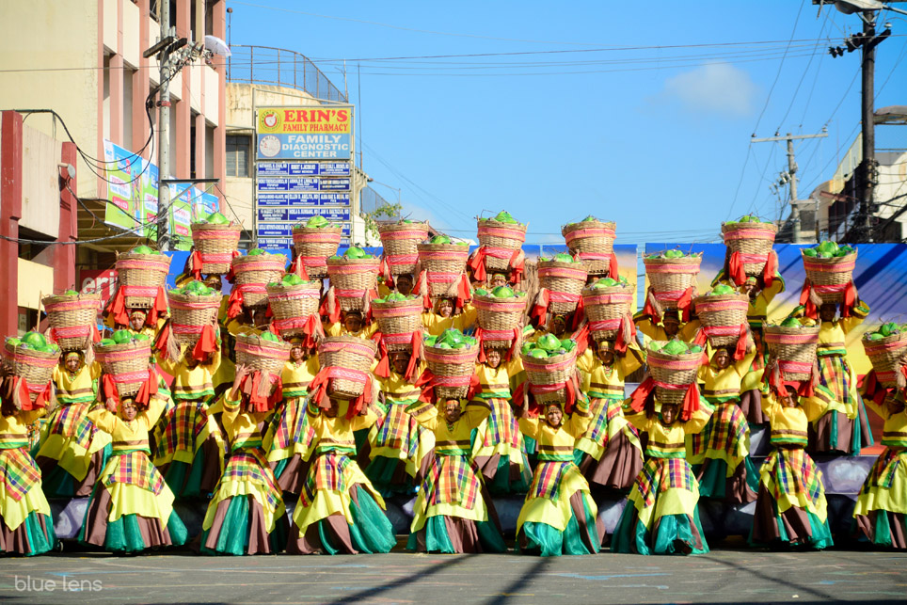
PHYSICAL EDUCATION
TOPIC 1: RELIGIOUS AND SECULAR FESTIVALS

Slide 28
PHYSICAL EDUCATION
TOPIC 1: RELIGIOUS AND SECULAR FESTIVALS
LECHON FESTIVAL
ang paryos kang ligad idya bala to sa banwa. Dan amo ra! Nga grabe udak ni ebon!

Slide 29
PHYSICAL EDUCATION
TOPIC 1: RELIGIOUS AND SECULAR FESTIVALS
LECHON FESTIVAL
Well, this festival of course highlights our addiction to Lechon. There are a lot of places in the country, that are known to be the place of the best lechon, pay hindi mag padaog ang Leon eh. Ja imo piggery nga! Basta about ja sa lechon. Pay sa Batangas gid ang grabe.

Slide 30
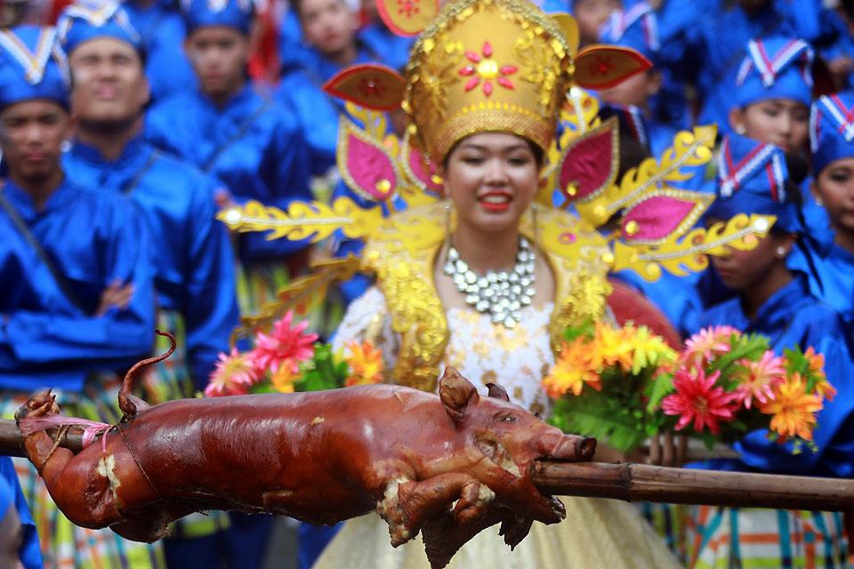
PHYSICAL EDUCATION
TOPIC 1: RELIGIOUS AND SECULAR FESTIVALS

Slide 31
PHYSICAL EDUCATION
TOPIC 1: RELIGIOUS AND SECULAR FESTIVALS
KADAYAWAN FESTIVAL
The Kadayawan Festival is an annual festival in the city of Davao. The festival is a celebration of life, a thanksgiving for the gifts of nature, the wealth of culture, the bounties of harvest and serenity of living. This occur every third week of August each year.

Slide 32
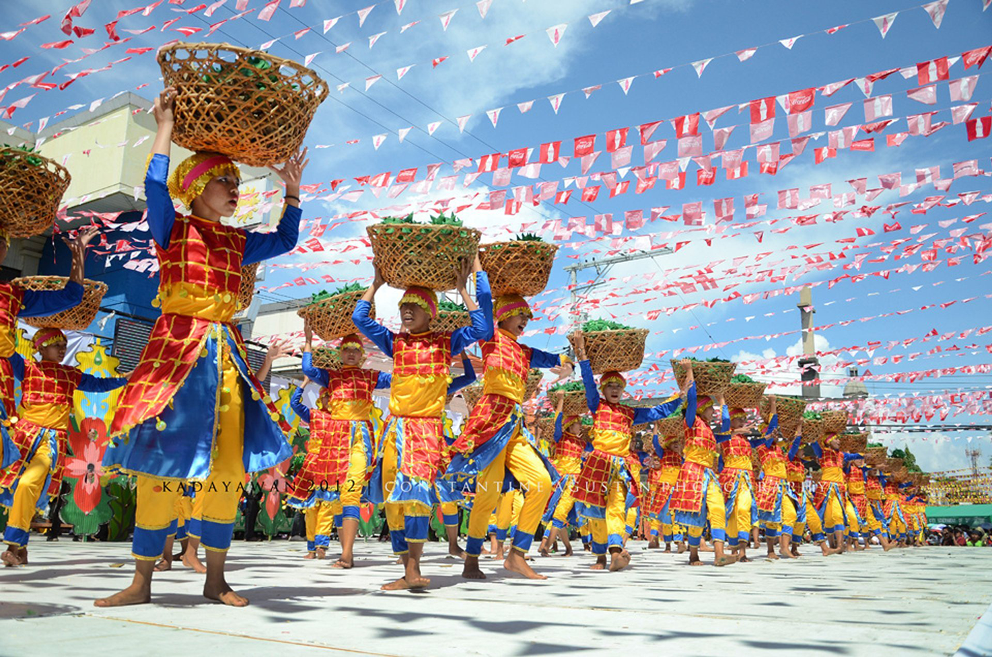
PHYSICAL EDUCATION
TOPIC 1: RELIGIOUS AND SECULAR FESTIVALS

Slide 33
PHYSICAL EDUCATION
TOPIC 1: RELIGIOUS AND SECULAR FESTIVALS
PANAGBENGA FESTIVAL
Panagbenga Festival is a month-long annual flower occasion in Baguio, Philippines. The term is of Kankanaey origin, meaning "season of blooming". The festival, held in February, was created as a tribute to the city's flowers and as a way to rise from the devastation of the 1990 Luzon earthquake. Kada 1st of February ja.

Slide 34
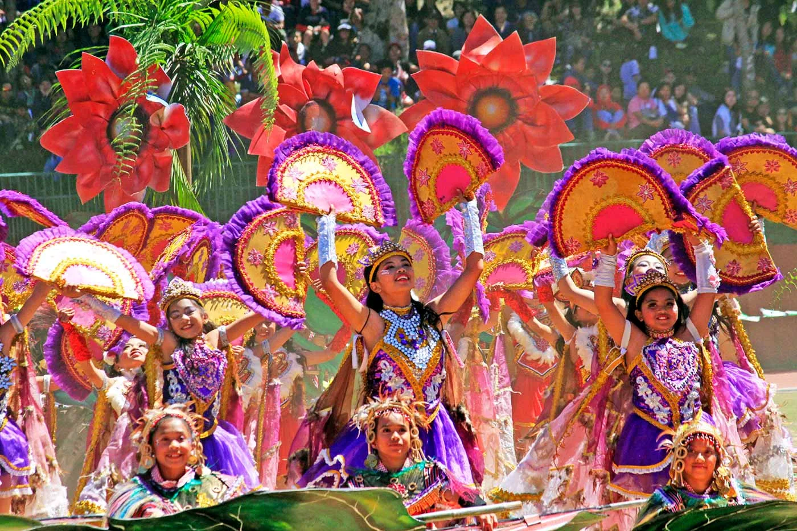
PHYSICAL EDUCATION
TOPIC 1: RELIGIOUS AND SECULAR FESTIVALS

Slide 35
PHYSICAL EDUCATION
TOPIC 1: RELIGIOUS AND SECULAR FESTIVALS
PARAW REGATTA
The Paraw Regatta Festival or Iloilo Paraw Regatta Festival is an annual festival held every third weekend of February in the Villa de Arevalo district, Iloilo City, Philippines. Its main event is a sailboat race in Iloilo Strait that features the paraw, a Visayan double-outrigger sail boat.

Slide 36
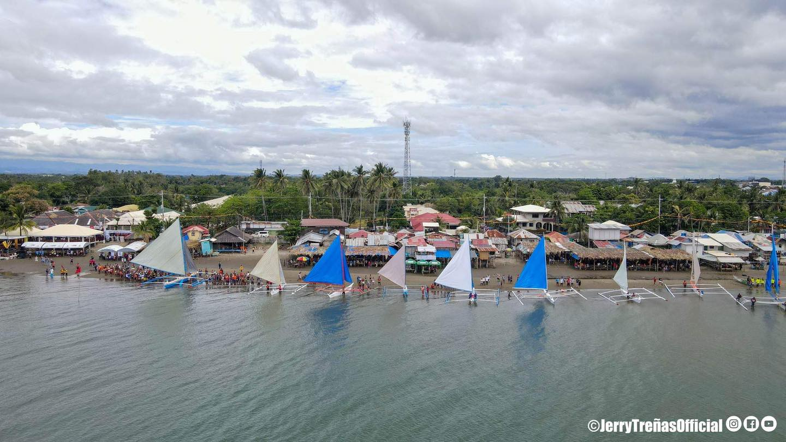
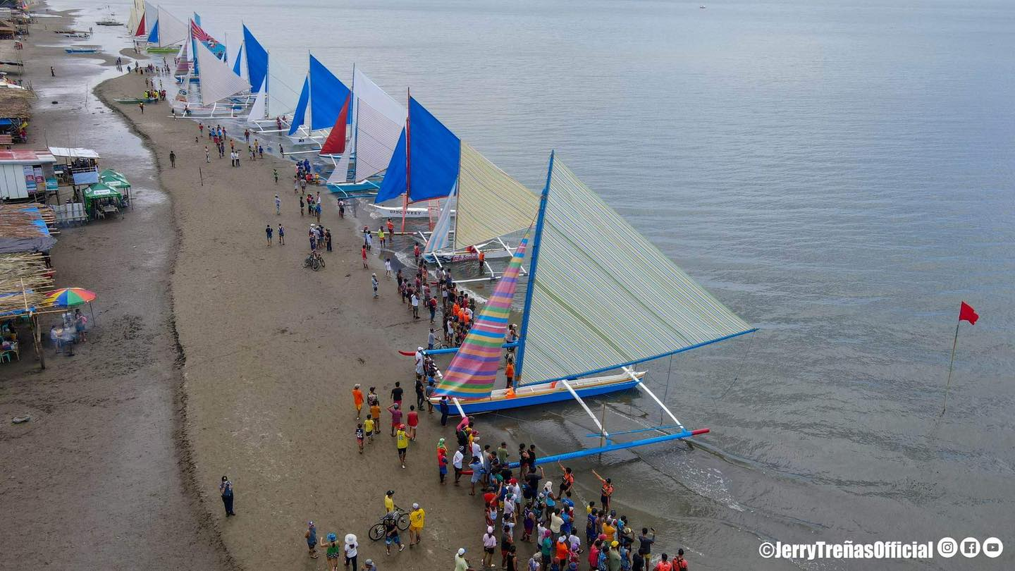
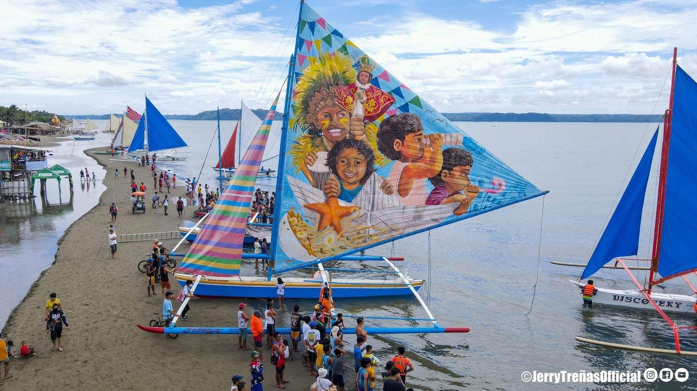
PHYSICAL EDUCATION
TOPIC 1: RELIGIOUS AND SECULAR FESTIVALS

Slide 37
PHYSICAL EDUCATION
TOPIC 1: RELIGIOUS AND SECULAR FESTIVALS
MASSKARA FESTIVAL
The MassKara Festival is an annual festival with highlights held every 4th Sunday of October in Bacolod, Philippines. The most recent festival was held last October 30, 2021. The festival sites include the Bacolod Public Plaza, the Lacson Tourism Strip and the Bacolod City Government Center.

Slide 38
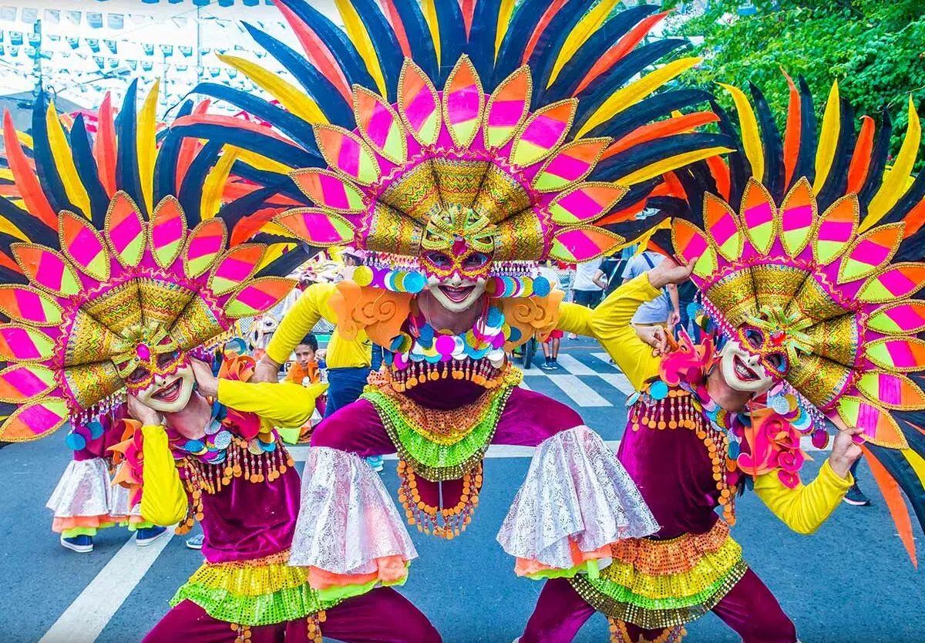
PHYSICAL EDUCATION
TOPIC 1: RELIGIOUS AND SECULAR FESTIVALS

Slide 39
PHYSICAL EDUCATION
TOPIC 1:
RELIGIOUS AND SECULAR FESTIVALS

